Slide 1
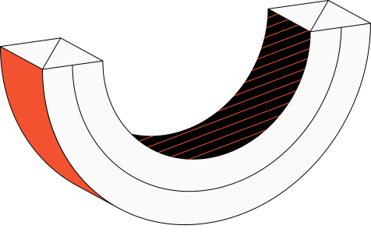
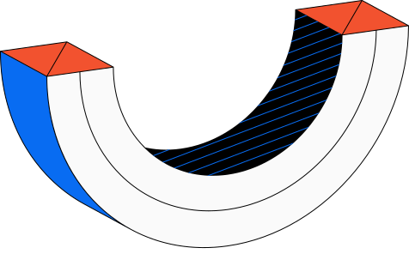

MEASUREMENT AND MAPPING OF GAS DISTRIBUTION IN INDOOR SPACES USING UAVs AND UGVs

Slide 2
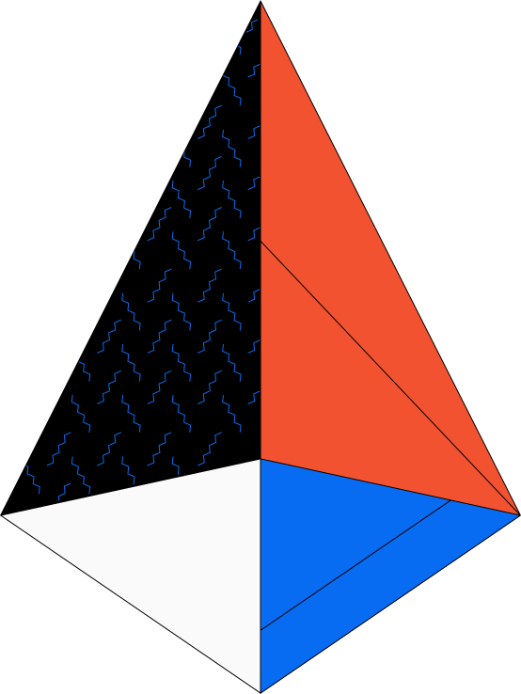

Team Project
Adrian Ferdinand Jotham
S1 - Teknik Komputer
1103200083
Aulia Samudra Jimananda
S1 - Teknik Komputer
1103201264
Fahmi Adhiwangsa
S1 - Teknik Komputer
1103204142

Slide 3

OUTLINE
1
Problems and Needs
2
Limitations and Desired Specifications
3
Proposed Solutions
4
System Design
5
Experimentations and Result

Slide 4
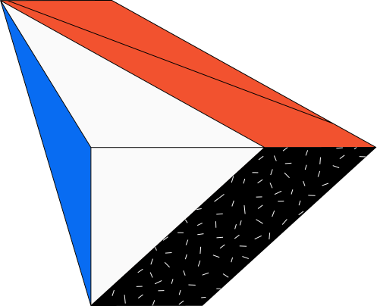
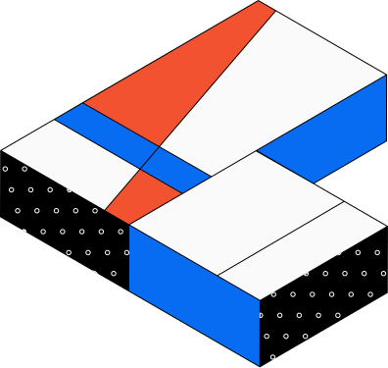
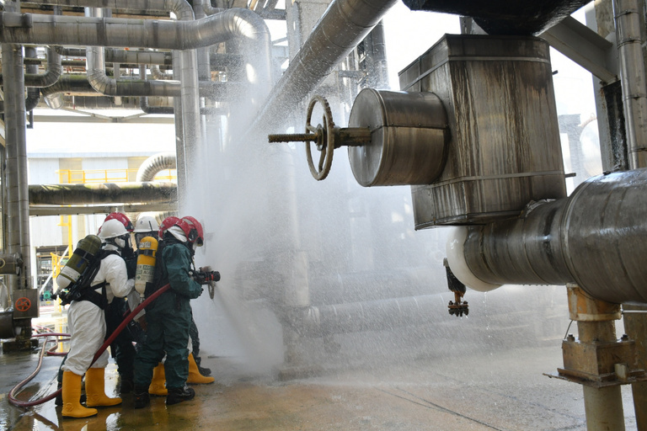

Problems
and Needs
The frequency of accidents and gas leak incidents in the chemical industry, which undoubtedly have serious consequences for the safety of workers and the surrounding community.

Slide 5
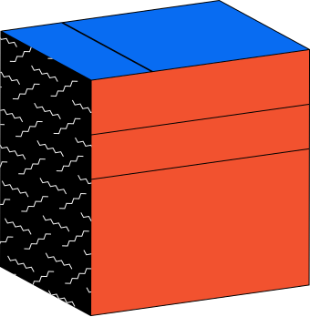
Limitations and Desired Specifications
Specifying the system for gas distribution measurement must consider various technical aspects.

Slide 6


Limitations | Limitations
Objective | Focuses on developing a system for measuring and mapping gas distribution in industrial areas.
Equipment | Utilizes a multi-robot platform.
Environment | Operates in an indoor environment with a pre-known room layout, covering an area of approximately 25 m².
Measured Object | Distribution of a gas dispersed within a room (Ethanol Gas).
Durability | The robots are capable of operating in a 25 m² room to fulfill its tasks.

Slide 7
Desired Specifications
Autonomous
Integrated Measurement
The robot can navigate the room independently, without human intervention.
The robot has been integrated with sensors to measure pollutant concentrations at a specific point.
Effective
Reduce the time required for measurements and provide more detailed results.
Endurance
Real-time Data
Can be deployed for a sufficient duration to perform comprehensive measurements
Collections and interpretation of data occur in real-time as measurements are taken, thereby speeding up decision-making

Slide 8
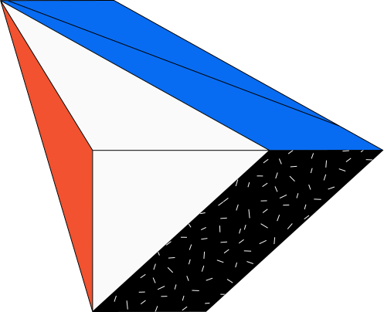

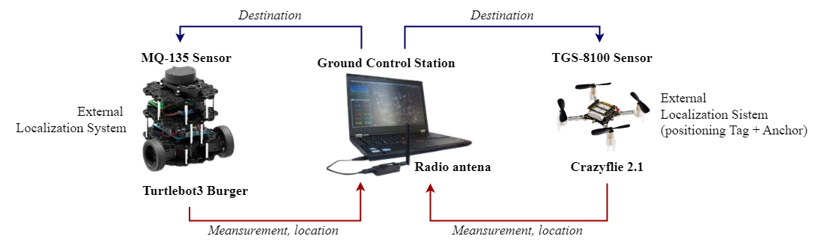
Proposed Solution
. . .

Slide 9
System Design
Technical Explanation of the Testing Scheme and How the System Works

Slide 10
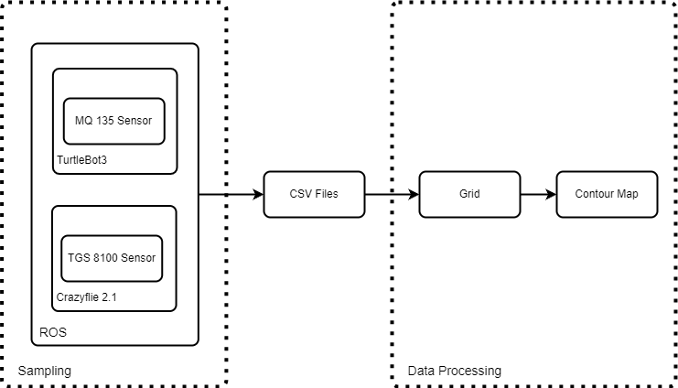
System Design

Slide 11
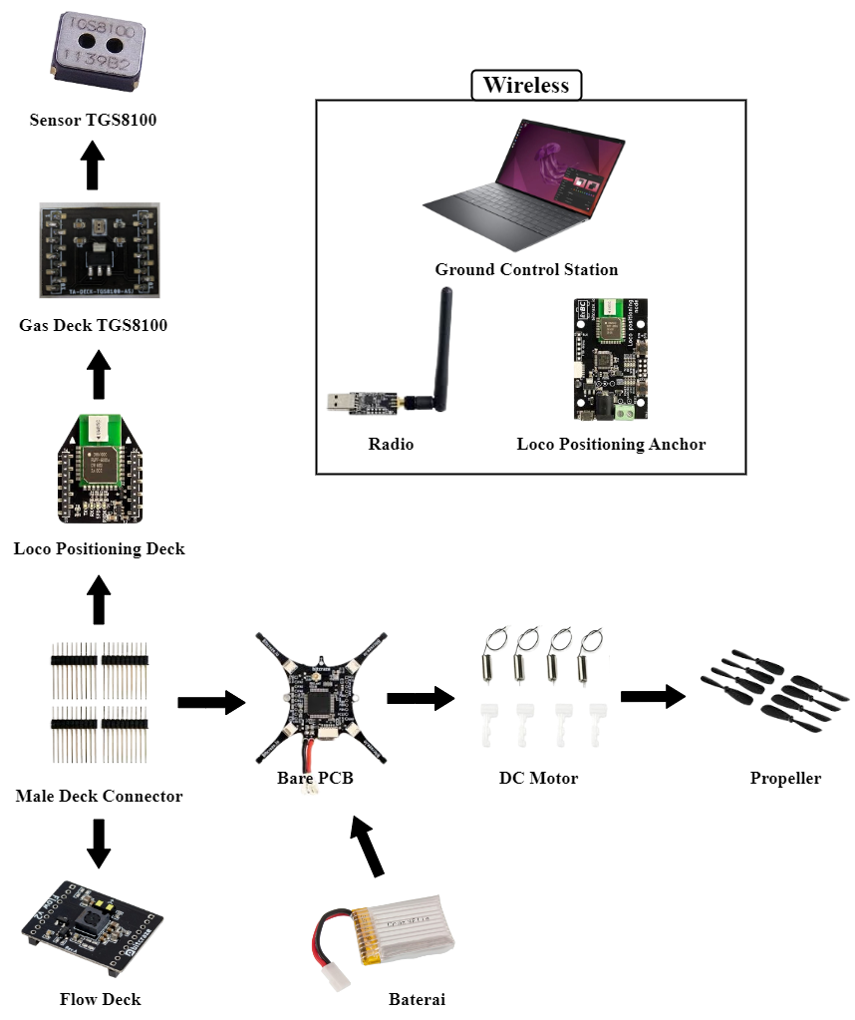
UAV’s Block Diagram

Slide 12
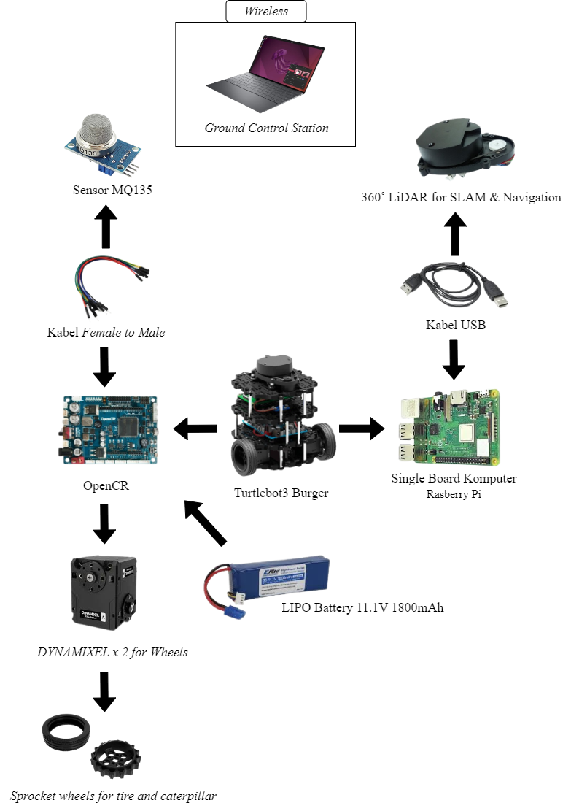
UGV’s Block Diagram

Slide 13
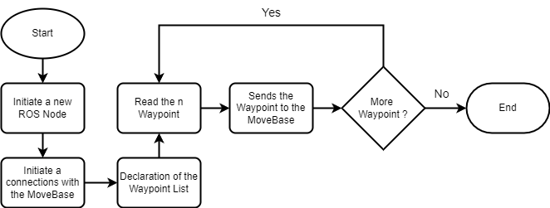
Navigations Algorithm (UGV)

Slide 14
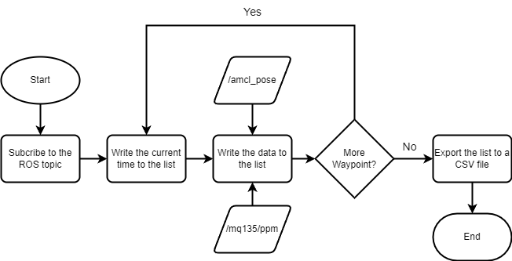
Gas Sampling (UGV)

Slide 15
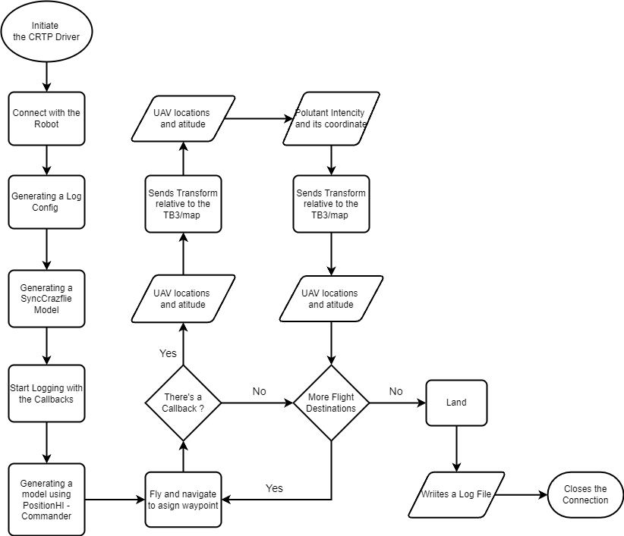
Navigations Algorithm (UAV)

Slide 16
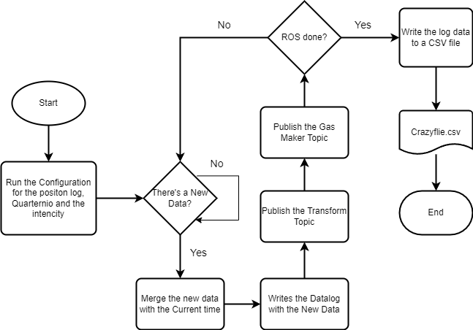
Gas Sampling (UAV)

Slide 17
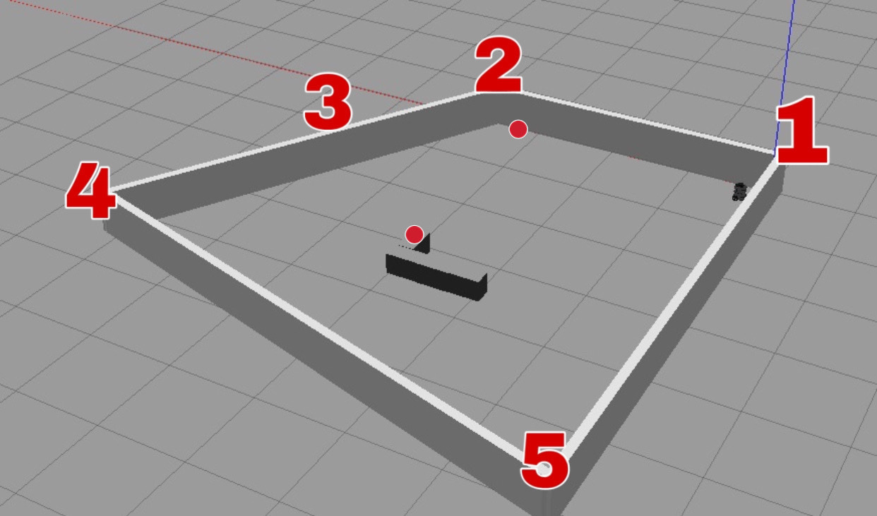
Room Schematic

Slide 18
Implementation

Slide 19
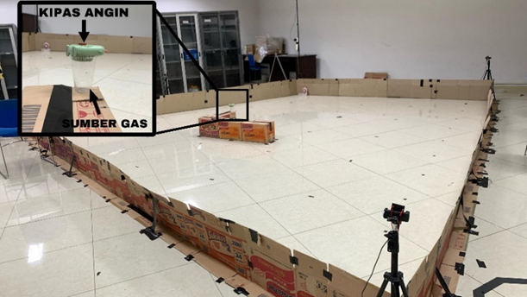
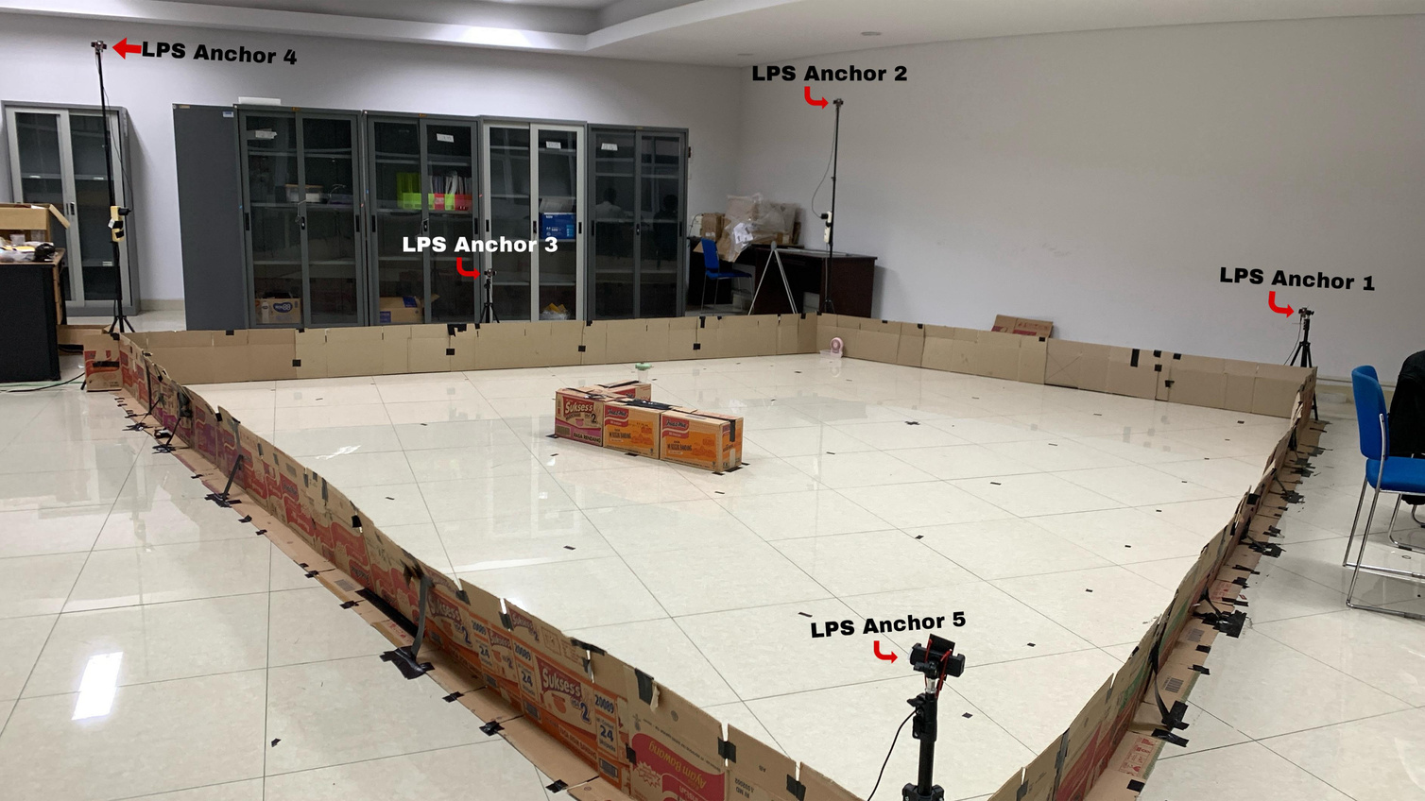
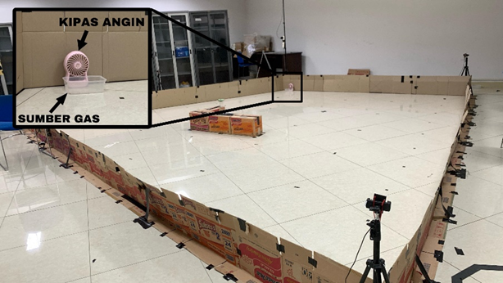
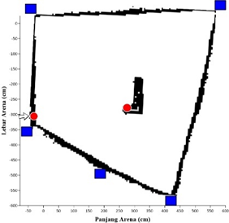
Room Implementaiton

Slide 20
List of Experiment
- Simulation -
- Field Test -

Slide 21
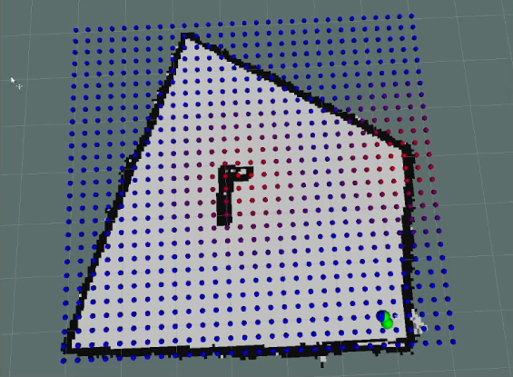
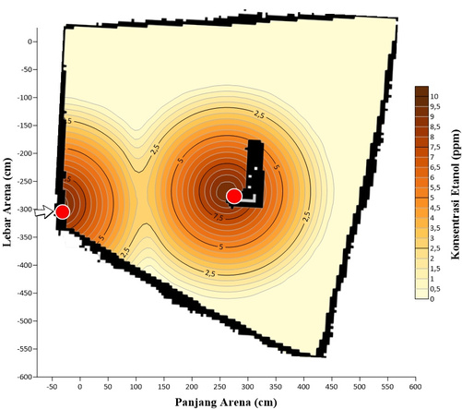
Simulation Environment
Ground Truth
(i)
(ii)
(iii)

Slide 22
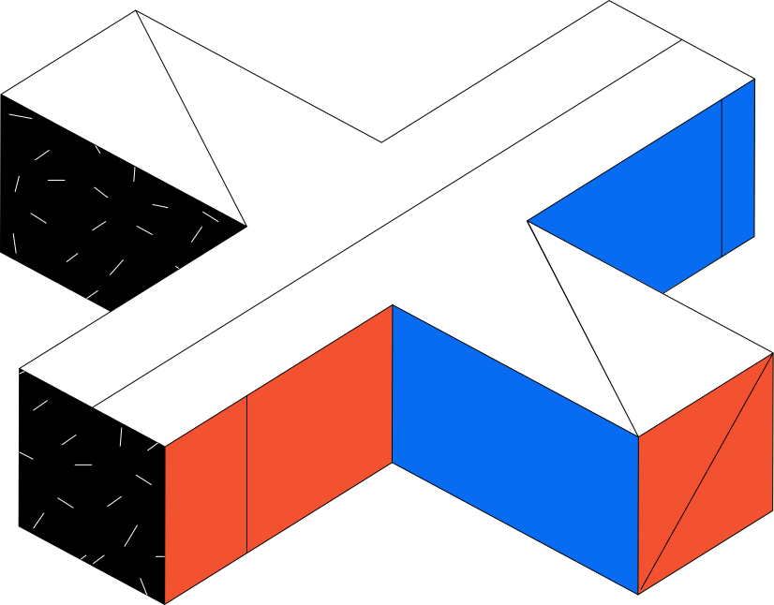
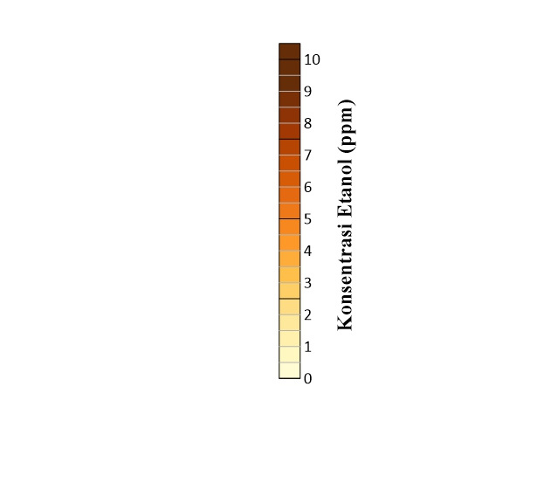
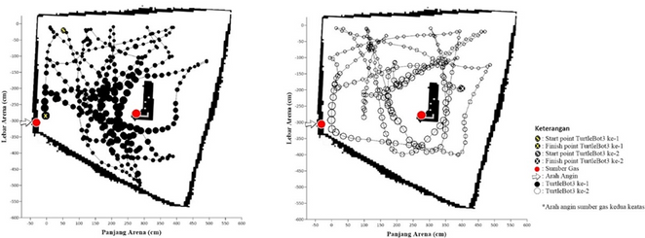
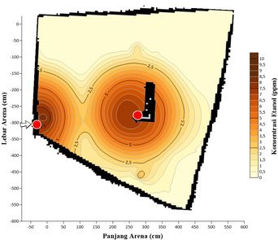
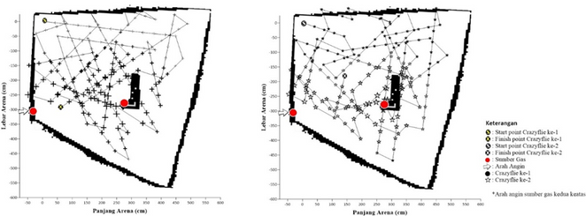
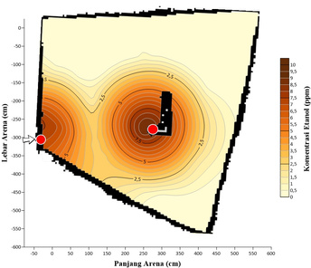
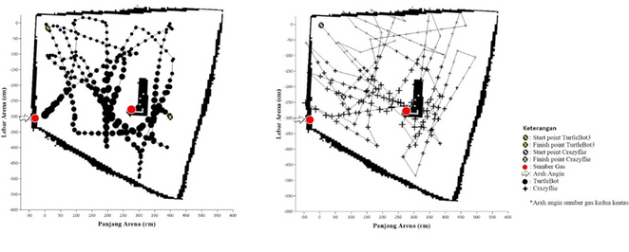

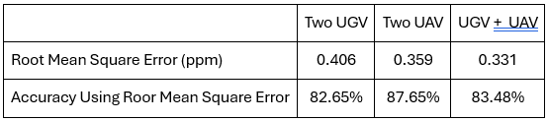
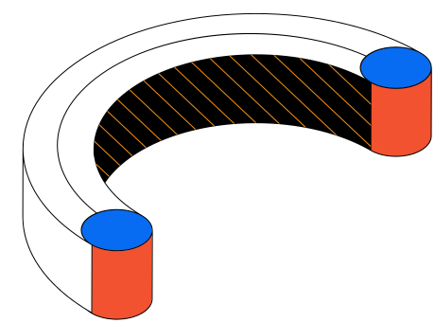
Simulations & the Results
Combinations
Movement Map
Result
UGV - UGV
UAV - UAV
Accuracy for every simulation
UAV - UGV

Slide 23
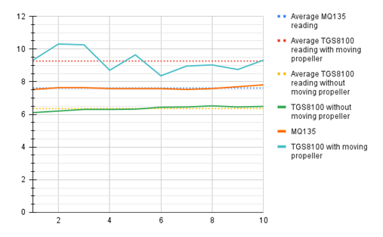
Data Normalization

Slide 24
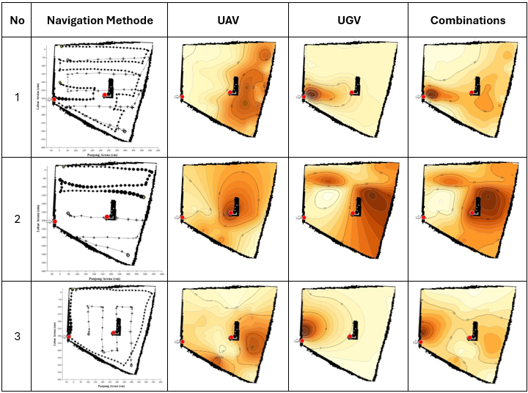
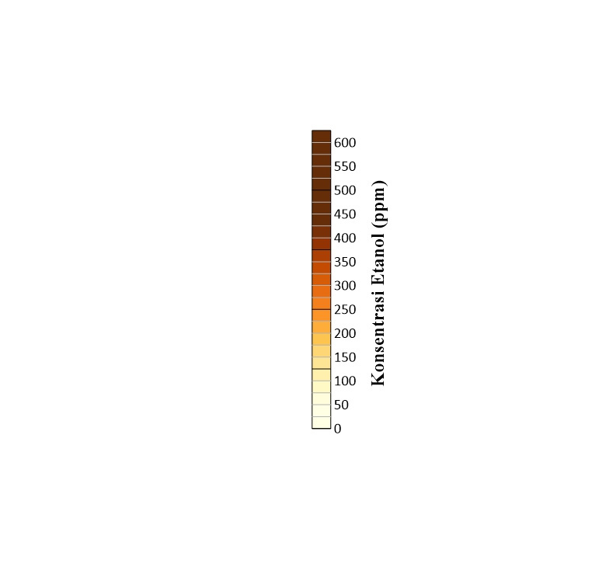
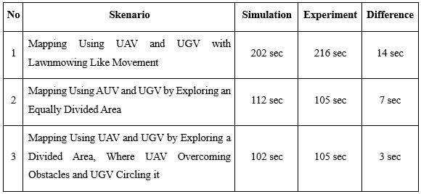
Navigation methods & the Results
Duration of movement

Slide 25
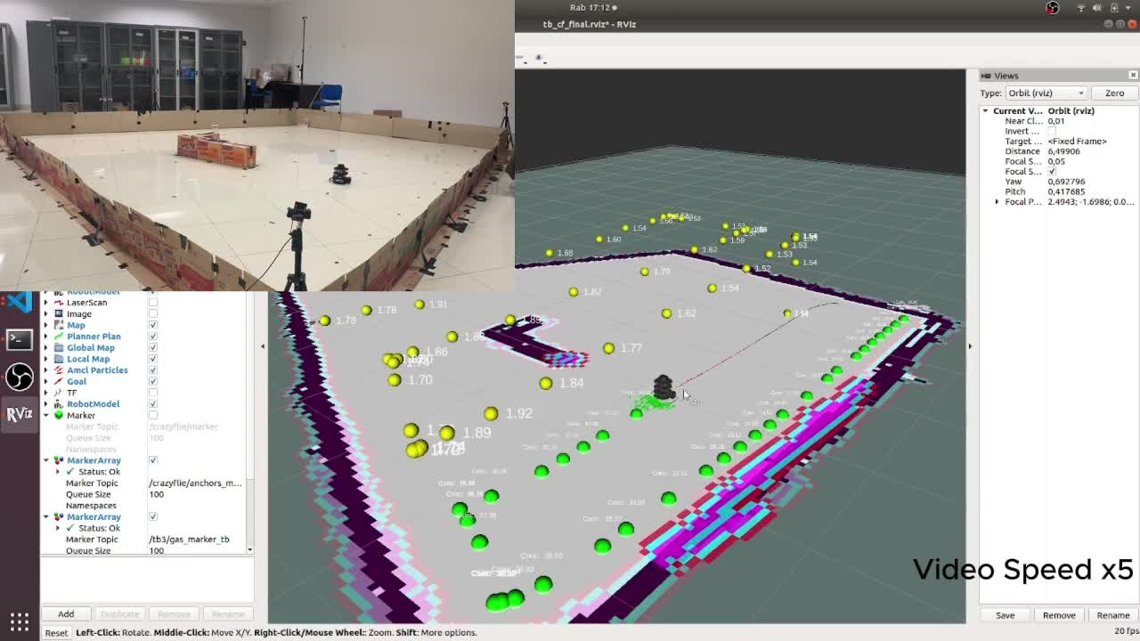
Real-Time Data Visualisation

Slide 26
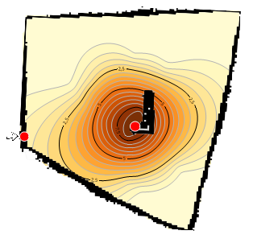
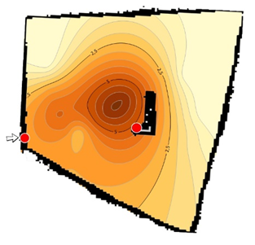
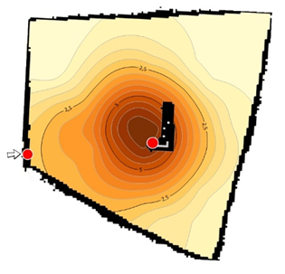
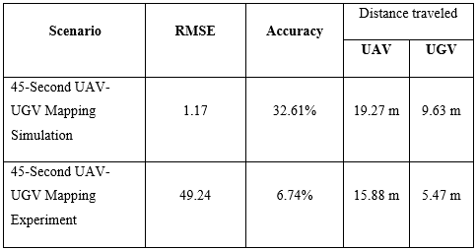
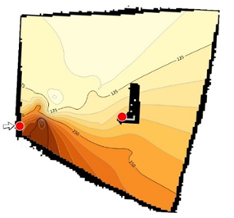
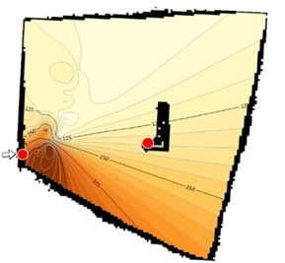
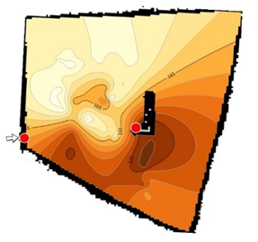
Limited Time (45 second)
UAV
UGV
Combined
Result

Slide 27
Conclusion
Sugestion
Developed a gas mapping system using UAVs and UGVs with ROS, featuring real-time ethanol detection.
Use Identical Sensor
Optimize sensor placement.
Explored various scenarios to improve accuracy based on terrain and operational duration.
Plan a realistic testing arena to eliminate unwanted factors.
Develop algorithms guiding robots to high-concentration areas to boost efficiency.

